Slide 1
IBM University Engagement Project Submission
“Agentic Career Counseling Companion”

Slide 2

Project Tile – Agentic Career Counseling Companion
Domain of Project- Education
Student Name | Recent Passport Photo | Email ID | Mobile number [WhatsApp]
Ronak Maheshwari |  | ronakmaheshwari.it26@jecrc.ac.in | 6376881458

Slide 3
Problem Statement -
Problem Statement: Agentic Career Counseling Companion
The Challenge : Students often struggle to make informed career decisions because of:
Fragmented access to career guidance
Limited awareness of their academic strengths
Difficulty identifying suitable career paths
Rapidly changing industry and job-market requirements
Lack of personalized and continuous career support
Traditional counseling being difficult to scale
The Objective
Build an AI-powered autonomous Career Counseling Agent that continuously analyzes student profiles, academic performance, interests and current industry trends to provide personalized, actionable and future-ready career recommendations.
Personalized Career Guidance – Recommend career paths based on skills, interests, academic performance, and goals.
Student Profile Analysis – Analyze academic records, projects, certifications, strengths, and preferences.
Career & Job Recommendation – Suggest suitable career paths and relevant job roles.
Skill Gap Analysis – Identify missing skills required for the student's target career.
Learning & Certification Recommendations – Suggest courses, certifications, and projects to build required skills.
Multi-Agent Career System – Use specialized AI agents for profile analysis, career recommendations, skill-gap analysis, industry trends, and personalized career roadmaps.
AI Career Assistant – Allow students to interact with the system through natural-language questions.
Progress Tracking Dashboard – Show career goals, skill progress, recommended learning activities, and career readiness.

Slide 4
Proposed Solution -
Proposed Solution: AI-Powered Agentic Career Counseling Companion
The proposed solution is a multi-agent AI-powered Career Counseling Companion built using IBM watsonx Orchestrate, IBM Granite Models, and IBM Cloud Lite services to provide personalized, intelligent, and continuously updated career guidance. The system addresses challenges in career selection, skill development, and industry awareness through an intelligent, modular architecture.
At its core, the solution uses a Retrieval-Augmented Generation (RAG) pipeline to retrieve relevant career information from trusted knowledge sources such as job descriptions, skill requirements, career pathways, courses, certifications, and industry trends. The retrieved information is provided to Granite models for analysis and generation of personalized career recommendations.
The system consists of six key agents:
Student Profile Agent analyzes academic performance, skills, projects, certifications, interests, and career preferences to create a comprehensive student profile.
Career Recommendation Agent evaluates the student's profile and recommends suitable career paths and job roles based on their strengths, interests, goals, and current market requirements.
Skill Gap Analysis Agent compares the student's existing skills with the skills required for the selected career and identifies areas that need improvement.
Learning Recommendation Agent suggests relevant courses, certifications, projects, and learning resources to help students develop the skills required for their target career.
Industry Intelligence Agent retrieves and analyzes current industry trends, emerging technologies, in-demand skills, and evolving job roles to ensure career recommendations remain relevant and future-ready.
Career Roadmap Agent combines the analysis from different agents to generate a personalized step-by-step roadmap covering skill development, projects, certifications, internships, and career goals.
The solution also includes a user-friendly career dashboard that visualizes student profiles, recommended career paths, skill gaps, learning progress, industry insights, and personalized roadmaps in one place.

Slide 5
Technology Used
IBM watsonx Orchestrate – For designing, coordinating, and automating multi-agent career counseling workflows.
IBM Granite Model – For natural language understanding, reasoning, profile analysis, and personalized career recommendations.
IBM Cloud – Provides the infrastructure to build, deploy, and scale the Career Counseling Companion in a reliable and secure cloud environment
RAG (Retrieval-Augmented Generation) – Used to retrieve relevant career, job-role, skill, and industry data first, then generate accurate and contextual recommendations.
IBM Watsonx.ai - For Granite model deployment, embeddings, AI workflows, and responsible AI capabilities.
Vector Database (FAISS/Chroma) – Used to store embeddings and enable fast retrieval of relevant career and industry information for the RAG pipeline.

Slide 6
Langflow component Used -
1) Chat Input – Interface where students enter their career queries, academic details, skills, interests, and career goals.
2) IBM watsonx AI Agent – Processes student input using IBM Granite models to generate personalized career guidance and recommendations.
3) IBM Granite Model – Granite-4.0-8B-Instruct → Used for natural language understanding, reasoning, profile analysis, and career recommendations.
4) Chat Output – Displays AI-generated responses such as career suggestions, skill-gap analysis, learning recommendations, and career roadmaps.
5) File Component – Stores and retrieves student profiles, resumes, career knowledge, job-role information, and skill datasets for analysis and RAG-based retrieval.
6) RAG / Knowledge Retrieval Component – Retrieves relevant career, skill, course, certification, and industry information to provide accurate and context-aware recommendations.

Slide 7
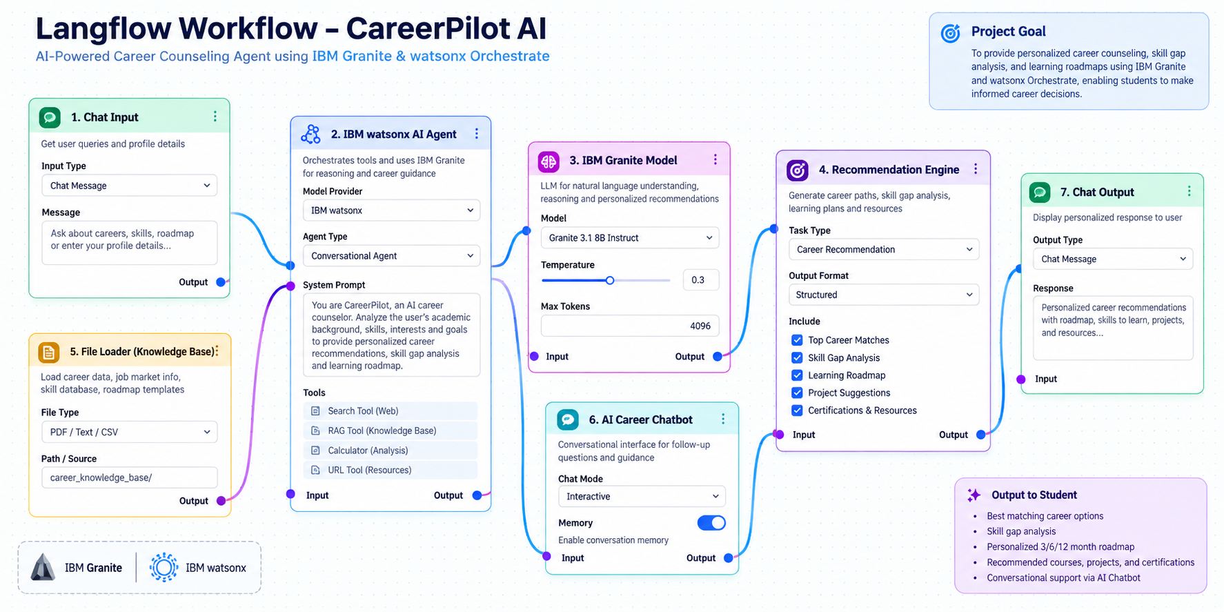
Langflow workflow -

Slide 8
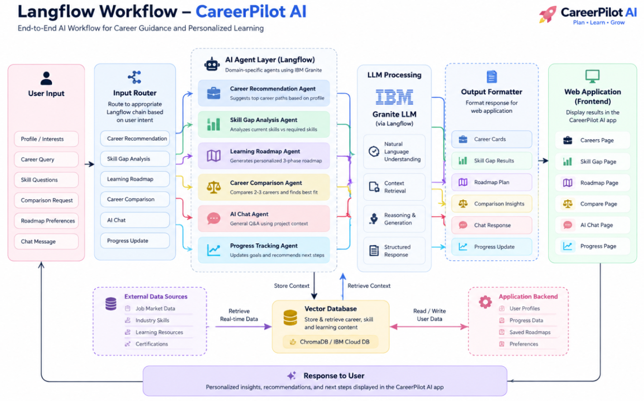
Architecture blueprint

Slide 9

Role of Agentic AI in the solution
Role of Agentic AI in CareerPilot AI
Agentic AI enables CareerPilot AI to function as an intelligent and adaptive career companion rather than a simple chatbot. Using IBM watsonx Orchestrate and IBM Granite, the system coordinates multiple specialized agents to analyze student profiles and deliver personalized career guidance.
Each agent performs a specific role—such as analyzing student profiles, recommending career paths, identifying skill gaps, generating learning roadmaps, comparing careers, and tracking progress—while working collaboratively. This multi-agent approach enables efficient task execution and more comprehensive career recommendations.
Agentic AI also provides context awareness, using information such as academic performance, technical skills, interests, experience, career goals, and learning preferences to generate relevant recommendations. It can adapt when students update their goals or progress, allowing the roadmap and recommendations to evolve accordingly.
The AI Career Chatbot further enables students to interact naturally with the system and ask questions about careers, skills, learning plans, and career transitions. The agents use the available student context to provide more relevant responses.
Overall, Agentic AI makes CareerPilot AI personalized, proactive, adaptive, and goal-driven, helping students make informed career decisions and continuously improve their career readiness.

Slide 10
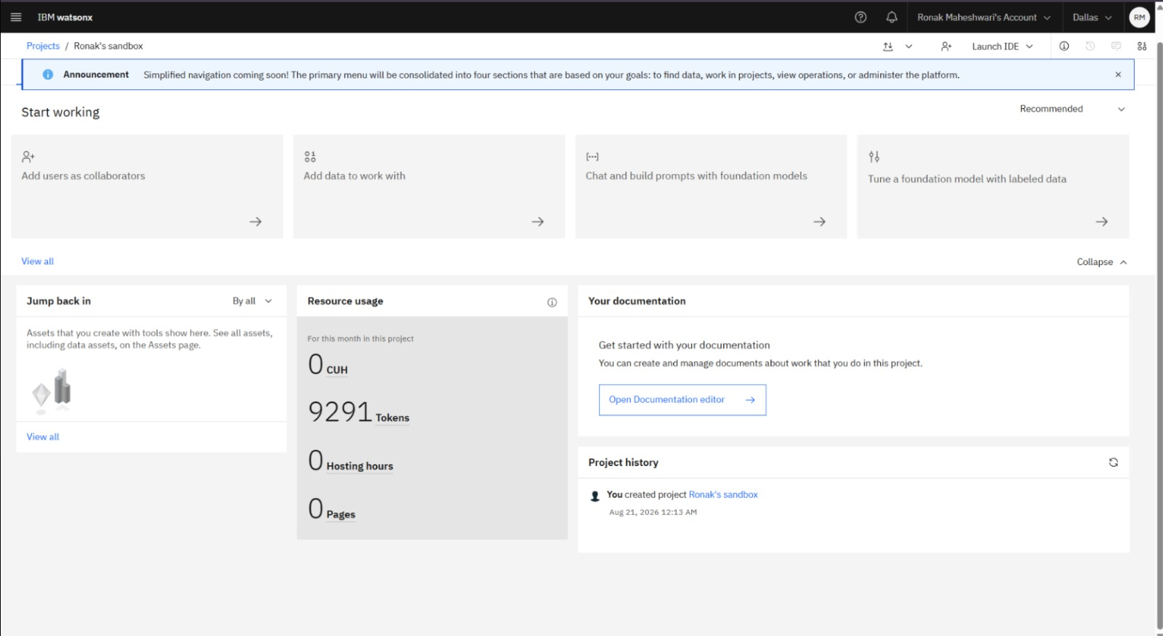
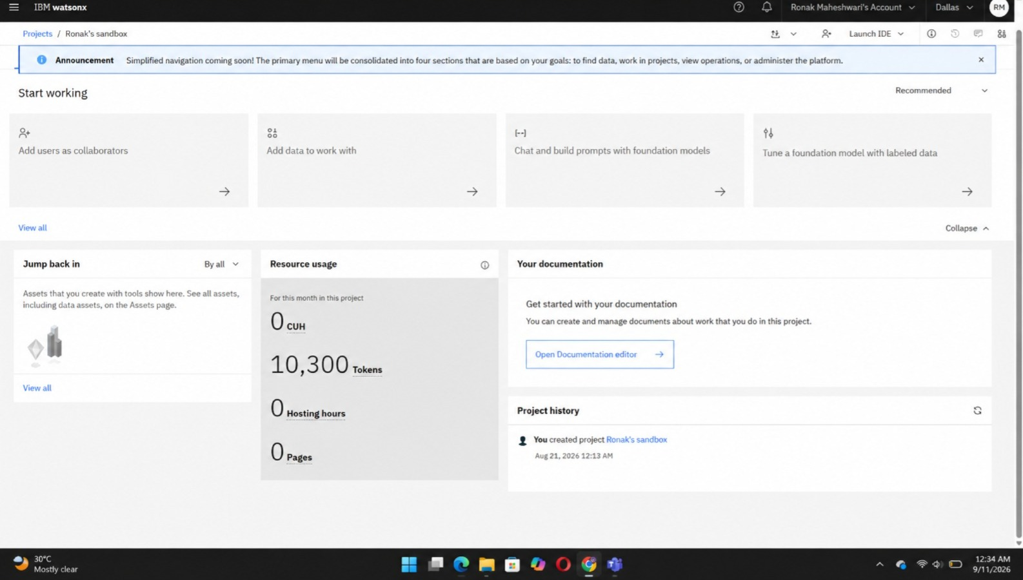
Token Usage
10,300 token are used
Before Prompt
After the Prompt
·
·
·

Slide 11
Novelty and Uniqueness
CareerPilot AI stands out by combining Agentic AI, personalization, skill-gap analysis, and adaptive career planning into a single intelligent career guidance system.
Multi-Agent Intelligence – Instead of relying on a single chatbot, multiple specialized AI agents collaborate to analyze the student's profile and provide comprehensive career guidance.
Personalized Career Matching – Matches students with suitable career paths based on their academic background, skills, interests, experience, and career goals.
Intelligent Skill-Gap Analysis – Identifies existing strengths and missing skills required for the recommended career, helping students understand exactly what they need to improve.
Adaptive Learning Roadmap – Generates a personalized 12-month learning roadmap with skills, projects, certifications, and activities aligned with the student's target career.
Career Comparison – Allows students to compare multiple career options based on skill fit, learning requirements, job roles, and recommended next steps.
AI Career Chatbot – Provides an interactive conversational interface where students can ask questions about careers, skills, roadmaps, projects, and career transitions.
Progress-Based Adaptation – Updates recommendations and learning plans as students complete skills, projects, certifications, or change their career goals.
IBM-Powered & Scalable – Built using IBM watsonx Orchestrate and IBM Granite, enabling an agentic workflow with enterprise-oriented AI capabilities.

Slide 12
Git Hub Link
Please create public github repository (Enable Add README button while creating repository) with format –
Please test and Paste the working Github URL – Ronak28M/CareerPilot-AI
Make sure you have Uploaded following three files into your github repository 1) app.json file , 2) yourproblemstatement.pdf file 3) your projectpresntation.pptx file 4)any other files
·
·
·

Slide 13
Future Scope
1. Real-Time Labor Market Monitoring –
The system can be enhanced to continuously monitor job-market trends, emerging career opportunities, industry demands, and in-demand skills. This will allow the Career Counseling Agent to automatically update career recommendations according to changing industry requirements.
2. Continuous Student Performance & Interest Tracking–
The system can continuously track changes in academic performance, skills, interests, and career preferences. Based on these changes, the AI agent can dynamically update the student's recommended career paths, skill requirements, and personalized career roadmap with minimal manual intervention.
3. AI-Powered Resume & Portfolio Guidance –
CareerPilot AI can be extended to analyze students' resumes, portfolios, and projects, identify improvement areas, and provide personalized suggestions to make their profiles more job-ready and aligned with target careers.
·
·
·

Slide 14
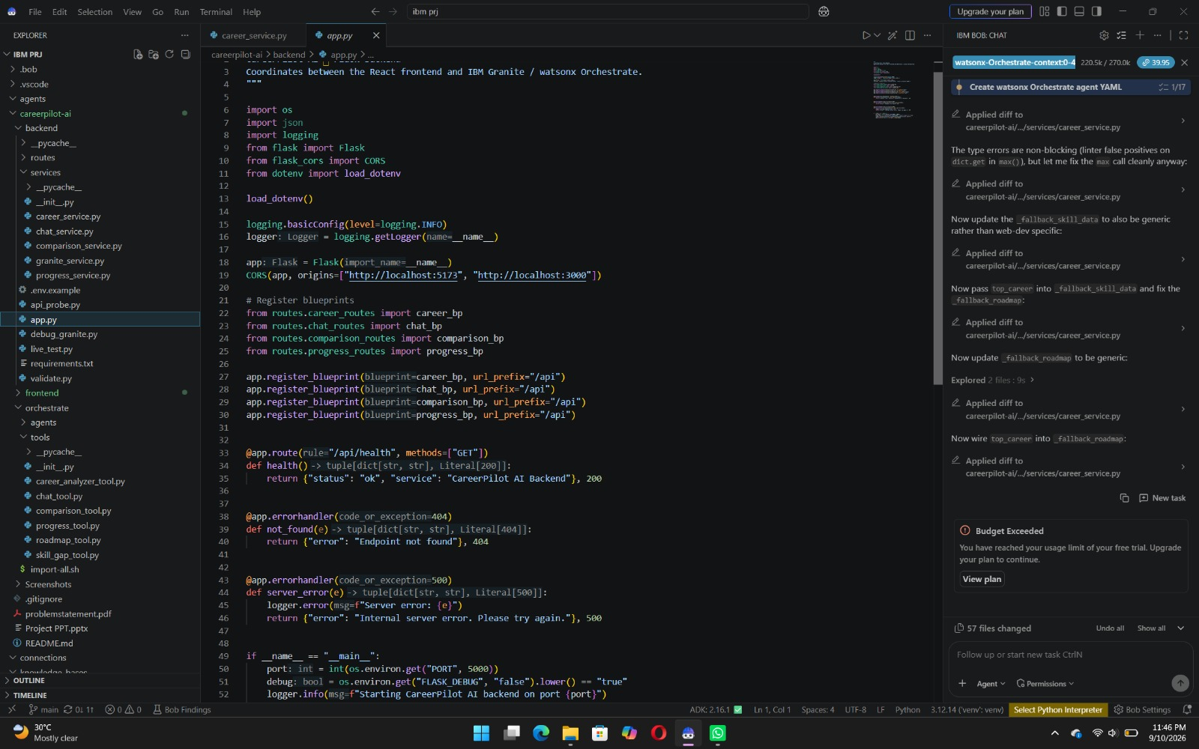
CODE SCREENSHOT

Slide 15
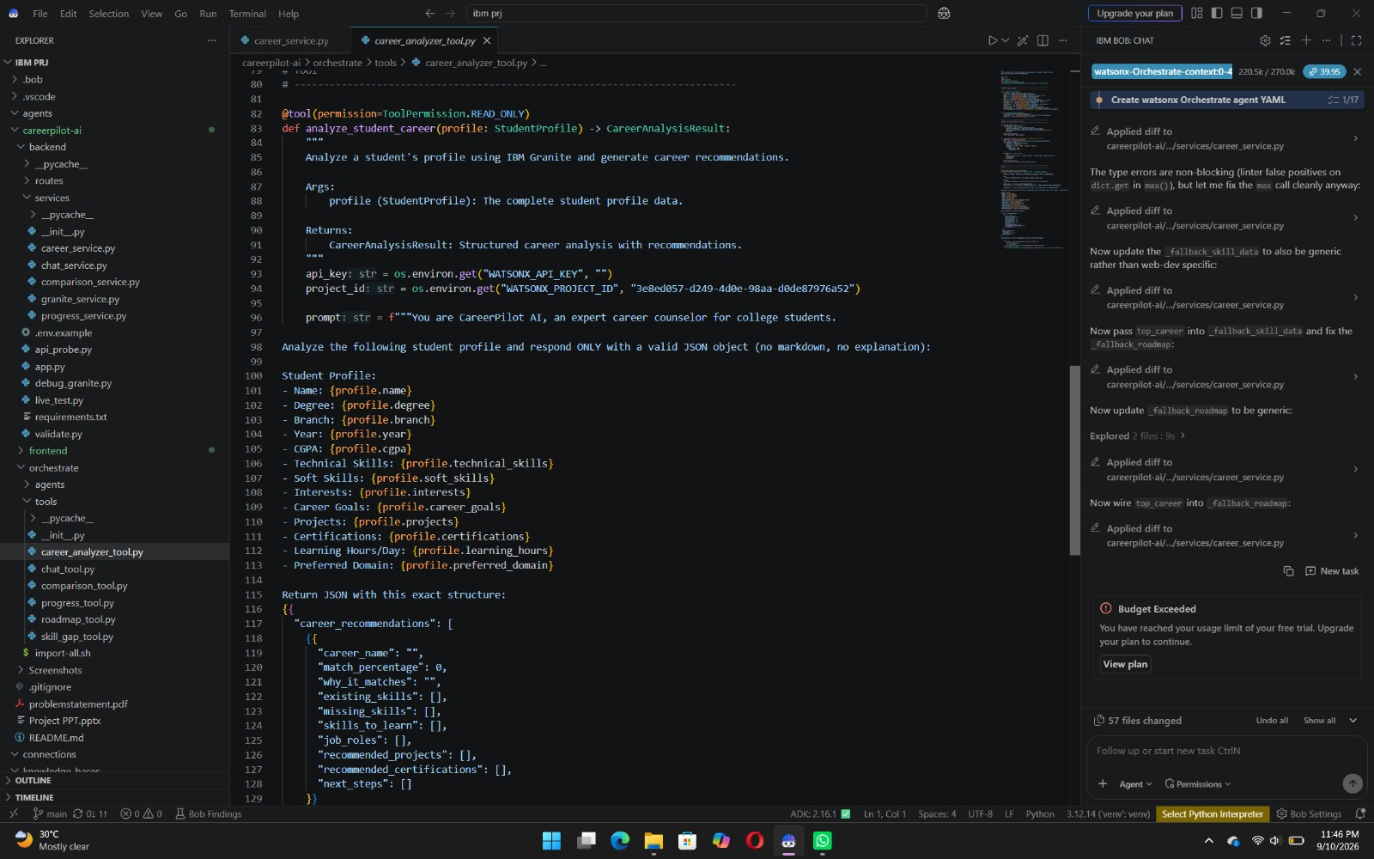
CODE SCREENSHOT

Slide 16
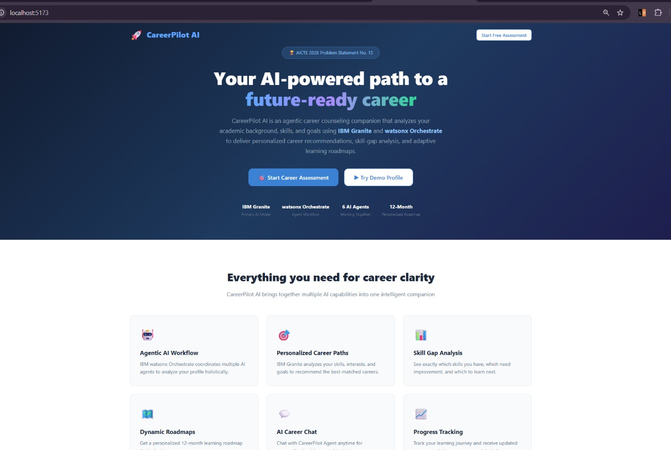
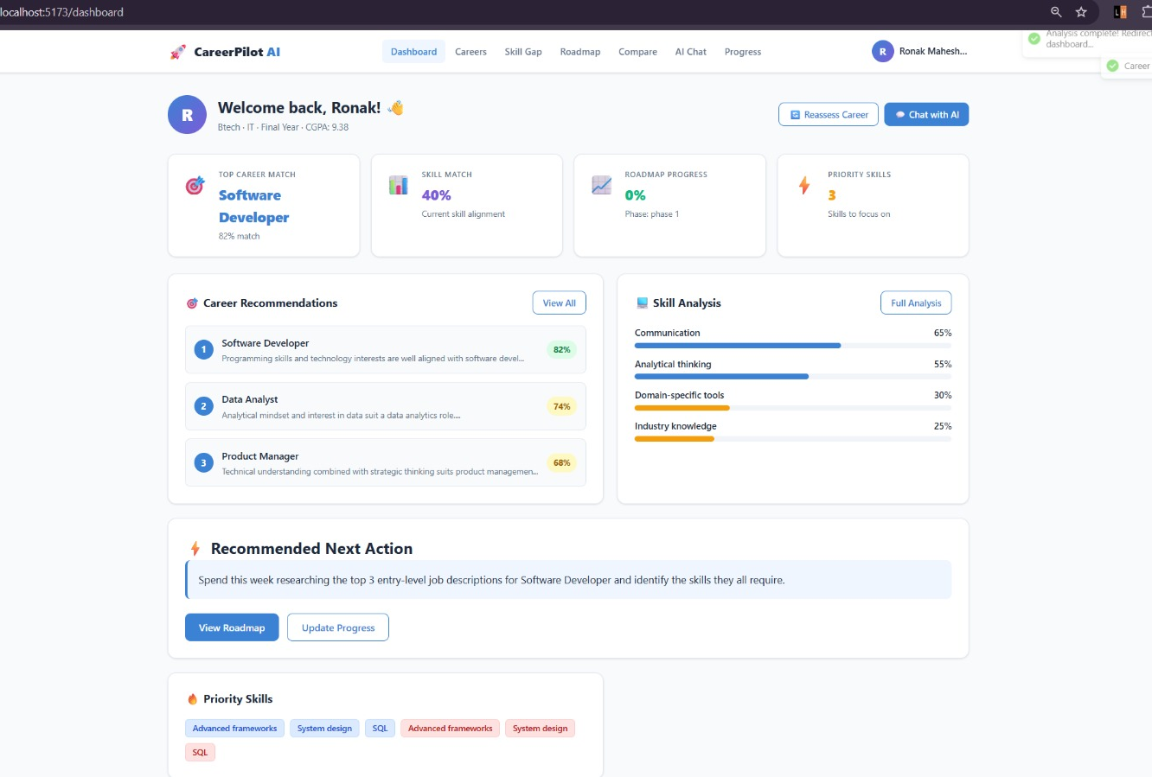
PROJECT SCREENSHOT

Slide 17
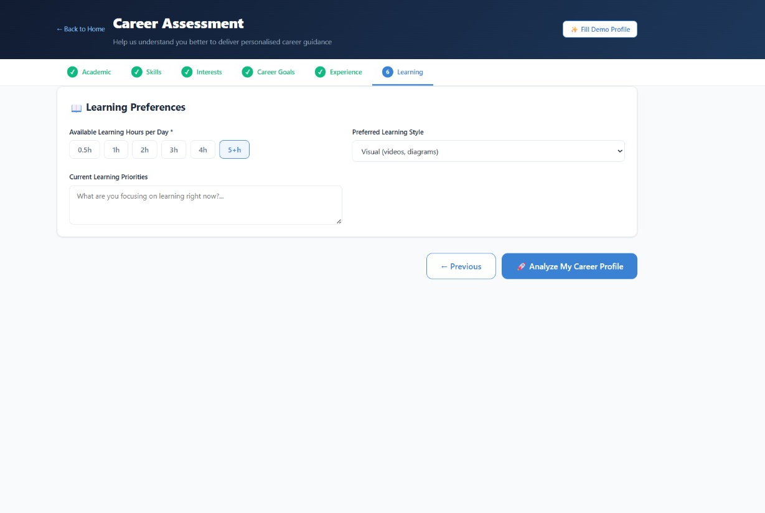
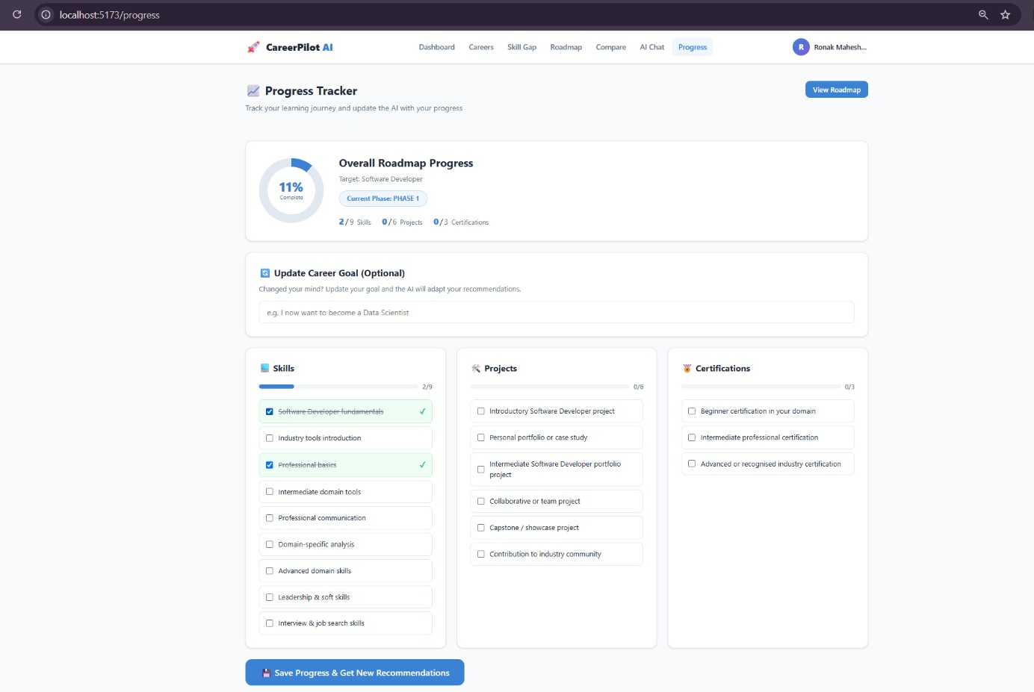
PROJECT SCREENSHOT

Slide 18
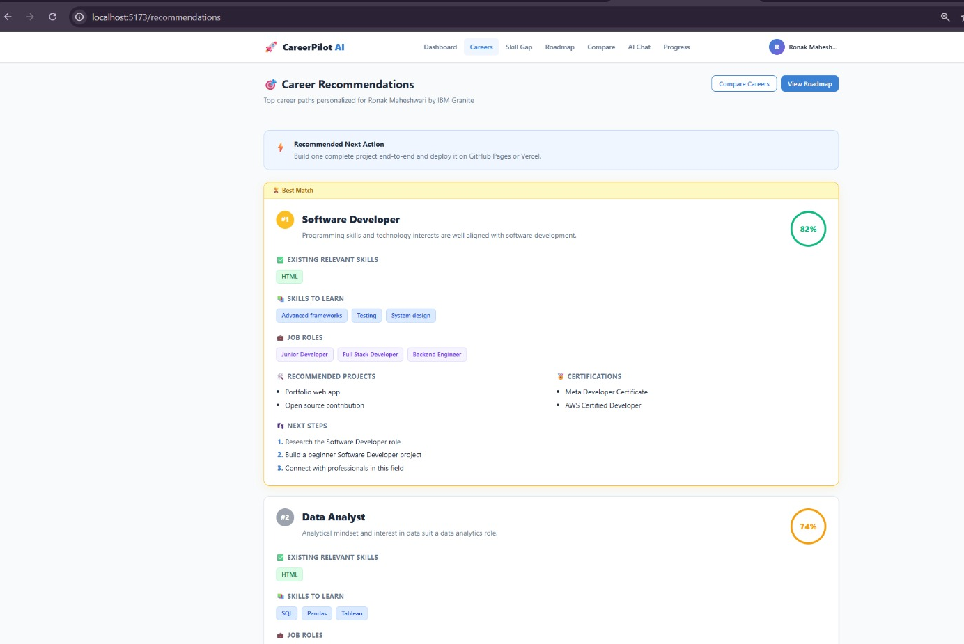
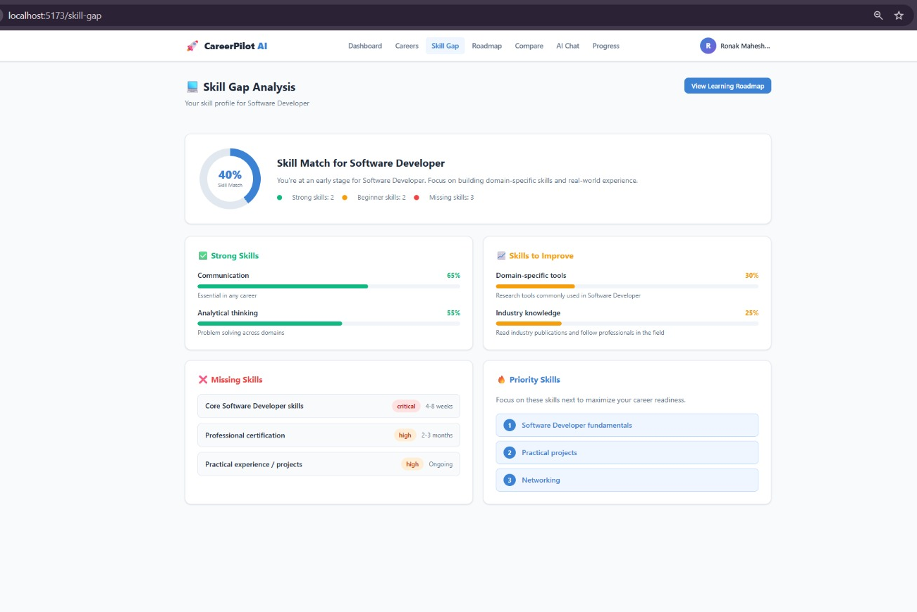
PROJECT SCREENSHOT

Slide 19
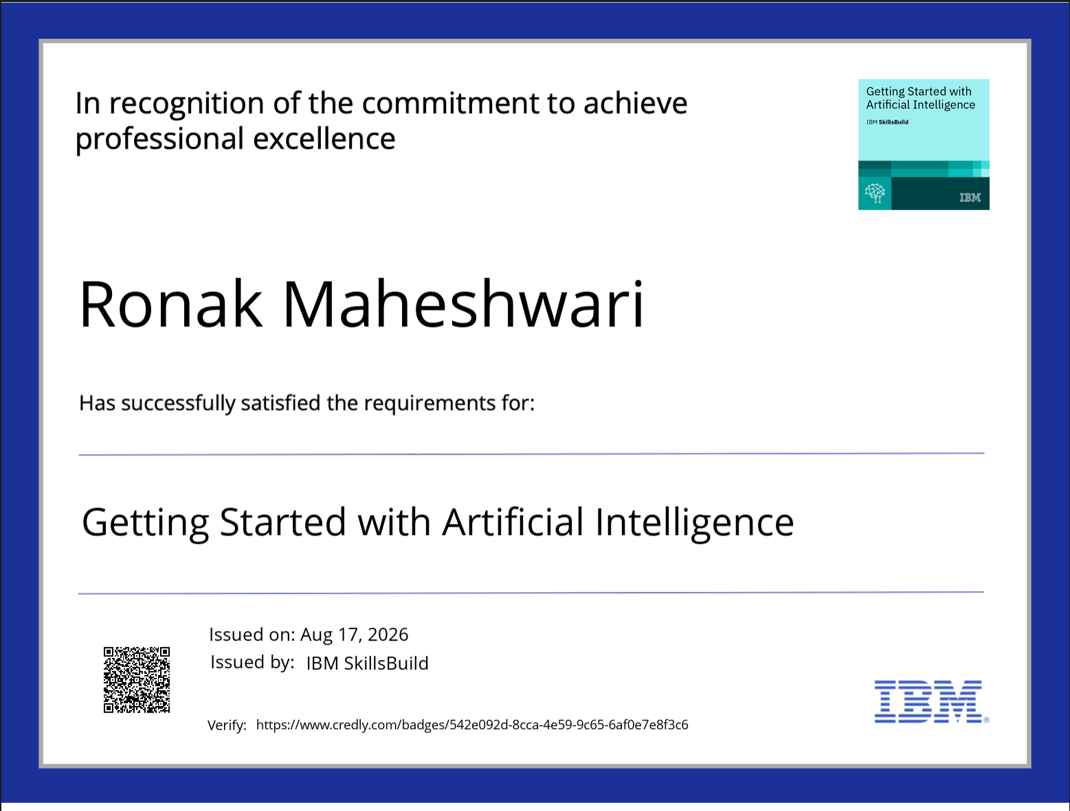
Certificates Earned:
Please add your credly certificate

Slide 20
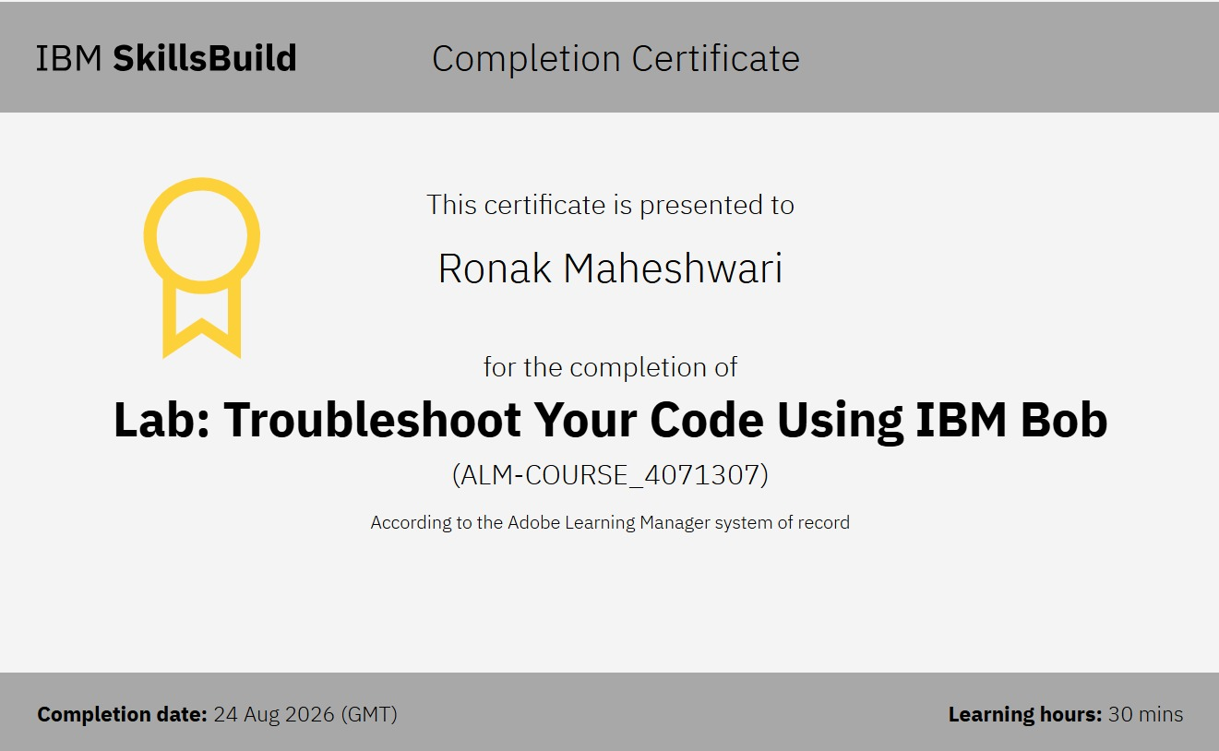
Certificates Earned:​
Add your IBM BOB Certificate

Slide 21


